Slide 1

Labano Academy Final Project
On
COVID 19 PANDEMIC
BY
COHORT-4
RICHARD AKINWARE

Slide 2
Introduction:
The COVID-19 pandemic has profoundly affected the world, prompting an urgent need for data-driven insights to understand its impact. Power BI provides a robust platform for analyzing pandemic-related data, empowering organizations to visualize trends, track case counts, and inform decision-making in the fight against the virus.

Slide 3

PROCESS WORKFLOW
Data Preprocessing
Data Collection
Data Analysis
Visualization
Recommendation
Conclusion

Slide 4
PROBLEM STATEMENT
The problem statement revolves around addressing the multifaceted challenges posed by the COVID-19 pandemic, spanning public health, socioeconomic, and logistical domains.
.

Slide 5
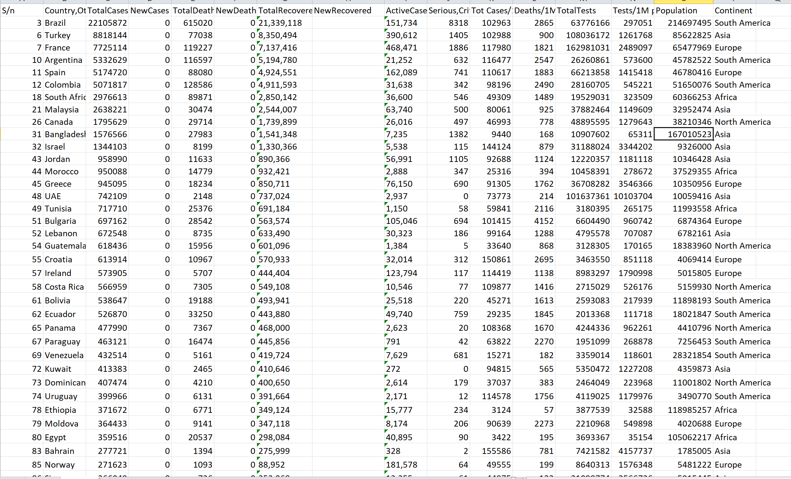
UNCLEAN DATA

Slide 6
DATA CLEANING PROCESS
1. Handling Missing Values
2. Dealing with Duplicates
3. Standardizing Data Formats
4. Handling Outliers
5. Addressing Inconsistencies

Slide 7
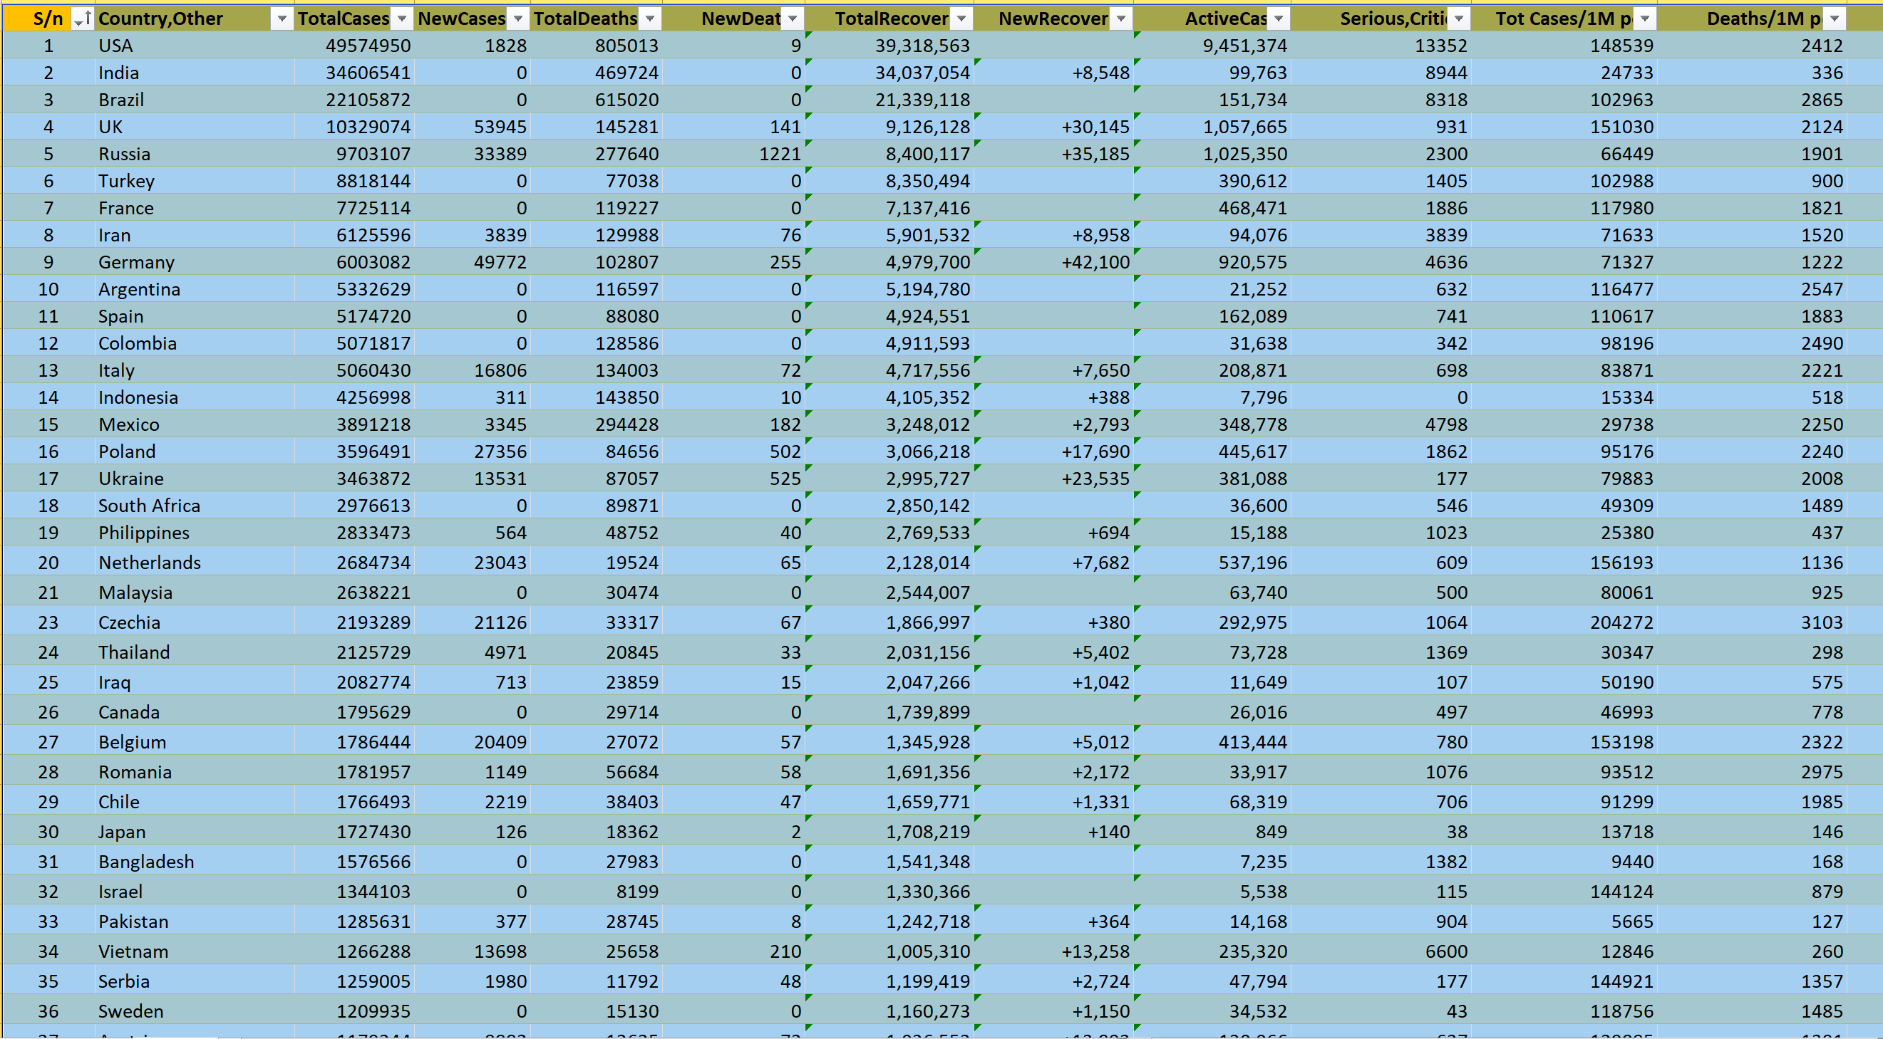
CLEAN DATA

Slide 8
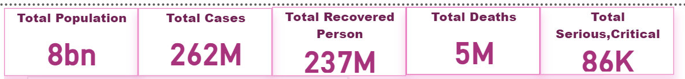
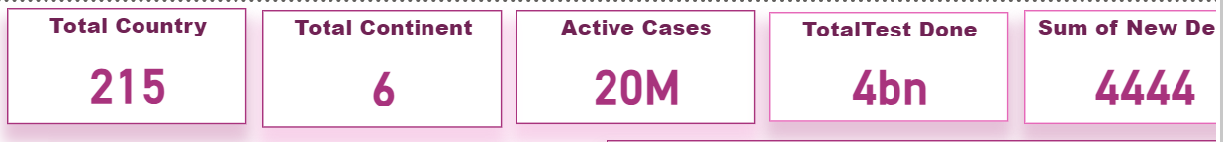
INSIGHT AND ANALYSIS

Slide 9
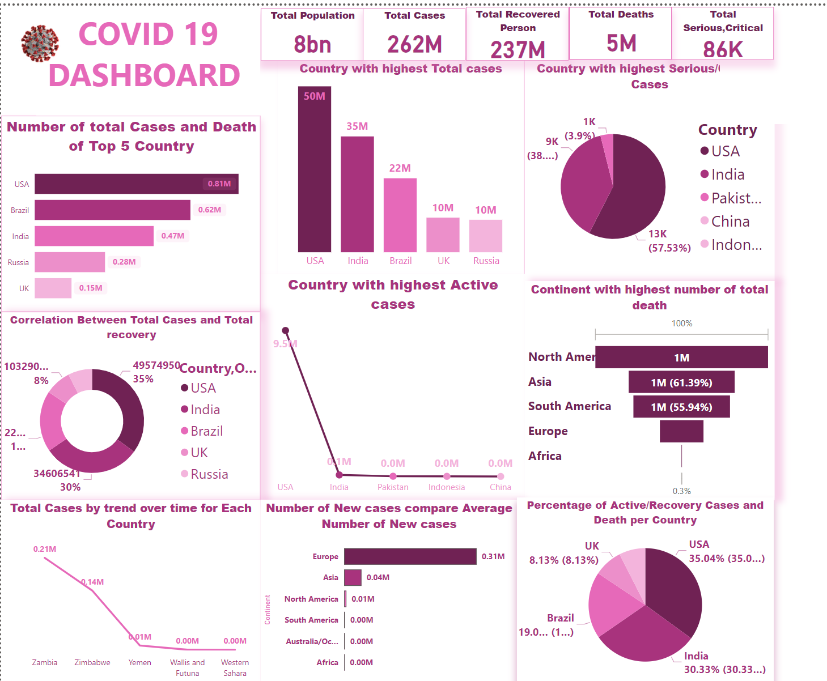

Slide 10
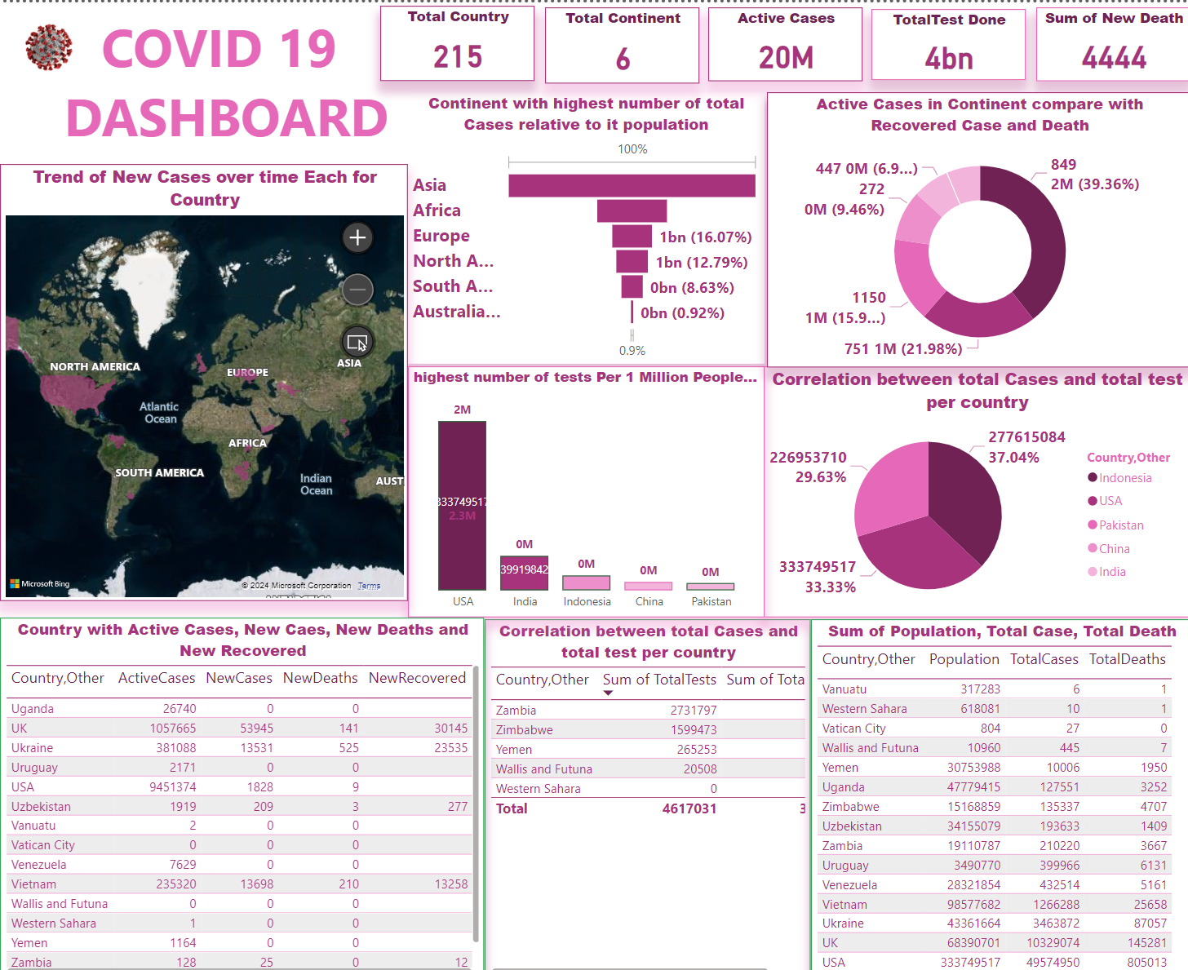

Slide 11
RECOMMENDATION
With the USA leading in both total cases and deaths among the top five countries, it's crucial to prioritize specific actions. This includes ramping up vaccination campaigns, raising public health awareness, and enforcing rigorous mitigation measures to contain the spread of COVID-19 and prevent additional loss of life. also improving healthcare capacity and ensuring access to medical resources
Considering that North America has recorded the highest total deaths and Asia has the highest number of cases per capita, it's imperative to implement targeted strategies. Accelerating vaccination campaigns, enforcing stringent public health measures, and bolstering healthcare infrastructure are essential to curbing the impact of COVID-19.

Slide 12
LIMITATION
Variations in healthcare infrastructure and access to testing could result in underreporting of cases in some regions
Discrepancies can significantly impact the comparability and interpretation of COVID-19 data, potentially leading to inaccurate assessments of the pandemic's severity and impact across different regions.

Slide 13
CONCLUSION
In summary, the data underscores the profound impact of COVID-19 at both national and continental levels. With the USA leading in total cases and deaths among the top countries, and North America bearing the brunt of the highest total deaths, the toll of the pandemic is undeniable. Furthermore, Asia's elevated number of cases relative to its population emphasizes the global scope of the crisis. Looking ahead, targeted interventions, international cooperation, and fair resource distribution are essential to contain the virus's spread and preserve lives across continents.

Slide 14


